Slide 1
PEOPLE'S DEMOCRATIC REPUBLIC OF ALGERIA · MINISTRY OF HIGHER EDUCATION AND SCIENTIFIC RESEARCH
University of Abdelhamid Mehri — Constantine 2
Faculty of New Technologies of Information & Communication (NTIC) · Dept. of Fundamental Computing & its Applications (IFA)
Master's Thesis — Computer Science · Option: STIC · 2025 / 2026
NEURACARD
A Multimodal Deep-Learning Platform for Predicting Non-Communicable Diseases
from ECG, EEG, MRI & Echocardiography, with explainable AI and a clinical workflow
Realized by: RAMOUL Mazen
Supervisor: Pr. DERDOUR Makhlouf Co-supervisor: Pr. TALBI Hichem
Constantine · June 2026

Slide 2
PRESENTATION OUTLINE
What this presentation will cover
01
Introduction
Digital transformation of medicine · The current landscape
02
Problem & Context
Diagnostic problem points · objectives
03
Proposed System
The platform · stakeholders · functionalities
04
Implementation
Architecture · model pipelines · frameworks · demonstration
05
Results
Datasets · training · metrics · explainable AI
06
Business Model & Future
Canvas · strategy · financials · market · future
07
CONCLUSION
OUTLINE
NEURACARD · 02 / 33

Slide 3
PART 01
01
Introduction
How medicine is being transformed by AI and why integrated tools are needed.
Imaging and signal analysis are going from reactive to predictive
AI now reaches clinically-competitive accuracy per modality
Yet the tools remain fragmented across specialities
INTRODUCTION
NEURACARD · 03 / 33

Slide 4
INTRODUCTION
A field influenced by AI
Cardiology, neurology and radiology are undergoing a deep digital transformation. Deep-learning models now read ECGs, EEGs, MRI scans and echocardiograms at a level that complements human expertise shifting care from reactive diagnosis toward earlier, predictive screening.
74%
of global deaths are caused by non-communicable diseases
Non-communicable diseases (NCDs) : cardiovascular disease, cancer and chronic neurological disorders is the diseases wihch does not spread from one person to another generally caused by genetics and unhealthy diet, are the dominant global health burden.
So making fast, accurate and accessible diagnostic , support a priority for every health system.
17.9M
cardiovascular-disease deaths .
the highest number of deaths worldwide each year
~10M
cancer deaths a year worldwide.
the second leading cause of death
Sources: World Health Organization (WHO)
INTRODUCTION
NEURACARD · 04 / 33

Slide 5
INTRODUCTION
The current landscape
Rising demand
AI has matured
The brain–heart link
Imaging and signal volumes climb every year more studies per patient and growing pressure on specialists.
Deep learning now reaches clinically-competitive accuracy on each modality one at a time.
Growing clinical evidence shows the heart and brain are coupled ,yet they are still a read apart.
Related work — existing AI is strong per modality, yet every system stays single-modality and standalone.
ECG
Hannun et al., Nature Med. 2019
Cardiologist-level arrhythmia detection from single-lead ECG.
ECHO
EchoNet-Dynamic, Nature 2020
Video CNN segments the LV and estimates ejection fraction.
MRI
nnU-Net, Nature Methods 2021
Self-configuring U-Net; won the BraTS tumor-segmentation challenge.
EEG
Schirrmeister et al., HBM 2017
Deep ConvNets decode raw EEG end-to-end (Braindecode).
INTRODUCTION
NEURACARD · 05 / 33

Slide 6
PART 02
02
Problem & Context
The key limitations of current diagnostic workflows and the need for integrated, explainable care
Fragmented, manual, single-modality and hard to trust
Each gap maps to a concrete objective on the next slide
PROBLEM & CONTEXT
NEURACARD · 06 / 33

Slide 7
PROBLEM STATEMENT
Five problem points in the current workflow
Siloed analysis
Cardiac (ECG/Echo) and neuro (EEG/MRI) signals of the same patient are read in separate systems — no cross-modal view.
Slow, manual segmentation
Tumor segmentation on MRI requires significant time and is subject to inter operator variability
No decision support
Outputs are black-box: nothing shows why a result was produced, slowing the trust.
Format mismatch
Hospital exports (DICOM / NIfTI / BrainVision) are not in the format models need.
Fragmented records
No unified patient history and no combined, cross-modality interpretation.
PROBLEM & CONTEXT
NEURACARD · 07 / 33

Slide 8
OBJECTIVES
What the platform sets out to do
Unify
Automate
Validate
Integrate ECG, EEG, MRI and Echo under one clinician-facing workflow.
Detect, segment and classify each modality with deep-learning pipelines.
Calibrate and fine-tune public models to clinically-competitive accuracy, measured honestly.
Explain
Secure
Deploy
Ensure every prediction is transparent and verifiable through Grad-CAM, SHAP, and 3D anatomical visualization.
Enforce role-based, assignment-scoped data isolation for medical privacy.
Ship a full-stack system with a combined PDF report and cloud deployment.
OBJECTIVES
NEURACARD · 08 / 33

Slide 9
PART 03
03
Proposed System
NEURACARD one platform, four modalities, one patient record.
Who it serves, how they use it, and what it does
Stakeholders · user journey · value · functionalities · planning
PROPOSED SYSTEM
NEURACARD · 09 / 33

Slide 10
PROPOSED SOLUTION
NEURACARD
NEURACARD is an AI-powered clinical decision support platform that integrates four medical intelligence modalities into a unified healthcare workflow. The platform enables clinicians to analyze multimodal patient data, including ECG, echocardiography, brain MRI, and clinical information, using specialized deep-learning models. Results are automatically stored in the patient's digital record, interpreted through explainable AI techniques, and Integrated into a unified clinical report to facilitate faster and better-informed diagnostic decisions.
USERS
INPUT
Cardiologists, neurologists, radiologists, general doctors plus a back-office technician.
Brain MRI · 12-lead ECG · echocardiogram video · EEG (.edf) — with a converter for raw clinic formats.
OUTPUT
VALUE
Segmentation, classification, EF & HRV, harmful-activity screen, SHAP/Grad-CAM overlays, 3D anatomy, combined PDF.
An integrated and explainable healthcare platform that streamlines clinical workflows.
PROPOSED SYSTEM
NEURACARD · 10 / 33

Slide 11
STAKEHOLDERS
Who uses NEURACARD, and how
D
T
P
H
Doctor
Technician
Patient
Hospital / admin
Primary user
Back-office
Beneficiary
Institution
Reviews assigned patients, runs analyses, reads explainable results and the 3D anatomy, generates the combined report.
Does intake, converts raw clinic files to model-ready formats, and assigns each patient to the right doctor(s).
Gains earlier, integrated screening across heart and brain and a clearer, explained result.
Standar dises diagnostics, raises throughput, keeps data on-premises, and builds a future-ready data asset.
PROPOSED SYSTEM
NEURACARD · 11 / 33

Slide 12
ADDED VALUE · USERS
Advantages for Healthcare Professionals
One workflow, four modalities
Instant reads
A future-ready data asset
No switching between separate cardiology and neurology tools.
Synchronous inference no waiting queue between upload and result.
Paired, same-patient multimodal data accrues the basis for cross-modal prediction.
Trustworthy results
Unified history
Human-in-the-loop
SHAP + Grad-CAM and a 3D organ show why each result was produced.
All of a patient's analyses in one record, plus one combined report.
Honest, auditable decision support
never an autonomous diagnosis.
PROPOSED SYSTEM
NEURACARD · 12 / 33

Slide 13
MAIN FUNCTIONALITIES
Core platform & intake (1 / 2)
Patient management
Data conversion (technician)
Assignment-scoped CRUD with a per-patient history view.
Raw DICOM/NIfTI/BrainVision/video → model-ready PNG/CSV/MP4/EDF.
EEG harmful-activity screen
MRI tumour analysis
6-class IIIC over 10-second windows with a harmful flag.
U-Net segmentation + Swin-T 4-class type with confidence.
ECG arrhythmia screening
Echocardiography
7 pathologies + HRV metrics from the raw 12-lead signal.
Ejection fraction + LV segmentation with a clinical category.
PROPOSED SYSTEM
NEURACARD · 13 / 33

Slide 14
MAIN FUNCTIONALITIES
Intelligence & output (2 / 2)
Explainability (SHAP ×4)
Interactive 3D anatomy
Grad-CAM + SHAP for all four models; per-lead/channel/frame importance.
A 3D brain/heart that glows the structure each finding implicates.
Combined PDF report
Multi-section ReportLab document with a rule-based interpretation.
PROPOSED SYSTEM
NEURACARD · 14 / 33

Slide 15
PART 04
04
Implementation
The architecture, the technology stack, and a walkthrough of the running platform.
Layered, modality-agnostic, doctor-isolated
React + Django + MongoDB · cloud-deployed
Eight live screens follow
IMPLEMENTATION
NEURACARD · 15 / 33

Slide 16
TECHNICAL ARCHITECTURE
Four layers, one data flow
FRONTEND
React 19 · Vite · Tailwind · Redux Toolkit · react-three-fiber 3D
Auth · Patients · MRI · ECG · Echo · EEG · Reports · Convert
▼
BACKEND / API
Django 3.2 · DRF · SimpleJWT — role-based, assignment-scoped REST
auth · patients · modality views · conversion · reports
▼
AI MODULE
Lazy singleton model loader · synchronous inference · explainers
U-Net · Swin-T · 7× DenseNet-1D · EchoNet · BIOT · Grad-CAM · SHAP
▼
DATA / STORAGE
Persistence & artefacts
MongoDB (djongo) · torch / HF weight cache · media/ (overlays · PDFs)
IMPLEMENTATION
NEURACARD · 16 / 33

Slide 17
MODEL PIPELINES
MRI & ECG — from input to result
MRI
›
›
›
›
MRI
Input
U-Net
Crop
Swin-T
Output
U-Net + Swin-T
256² brain scan
tumour mask
bbox of tumour
4-class type
type + Grad-CAM
ECG
›
›
›
›
ECG
12-lead
7× DenseNet-1D
Thresholds
NeuroKit2
Output
7× DenseNet-1D
per-lead norm
probabilities
calibrated
HRV metrics
7 findings + plot
IMPLEMENTATION
NEURACARD · 17 / 33

Slide 18
MODEL PIPELINES
Echo & EEG — from input to result
ECHO
›
›
›
ECHO
Video
DeepLabV3
R(2+1)D-18
Output
DeepLabV3 + R(2+1)D
112² · 32-frame clips
LV segmentation
EF regression
EF % + LV mask
EEG
›
›
›
›
EEG
.edf
10 s windows
BIOT
IIIC head
Output
BIOT + IIIC head
16-ch @ 200 Hz
STFT tokens
encoder
6-class
harmful flag
IMPLEMENTATION
NEURACARD · 18 / 33

Slide 19
FRAMEWORKS & LIBRARIES
The technology stack
Frontend
Backend
React 19
Vite
Tailwind CSS
Redux Toolkit
Django 3.2
Django REST Framework
SimpleJWT
react-three-fiber
Axios
i18next
djongo
ReportLab
gunicorn
AI / ML
Data & Deploy
PyTorch
torchvision
HuggingFace Transformers
MongoDB Atlas
Hugging Face Spaces
Vercel
Captum (SHAP)
NeuroKit2
ecglib
BIOT
Docker
GitHub Actions CI
MNE · pydicom · nibabel
IMPLEMENTATION
NEURACARD · 19 / 33

Slide 20
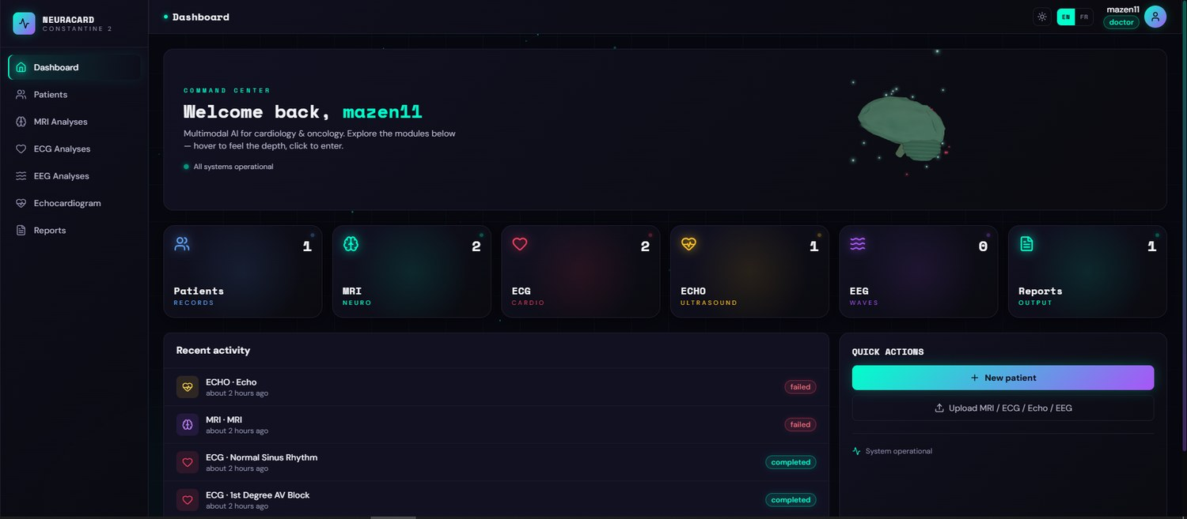
DEMONSTRATION · DOCTOR
Doctor dashboard
Assigned caseload
A doctor sees only the patients assigned to them.
Recent activity
Latest analyses with status badges and findings.
Quick actions
New patient, or jump straight to any modality.
The doctor's home after login — assigned patients, recent activity and quick actions.
IMPLEMENTATION
NEURACARD · 20 / 33

Slide 21
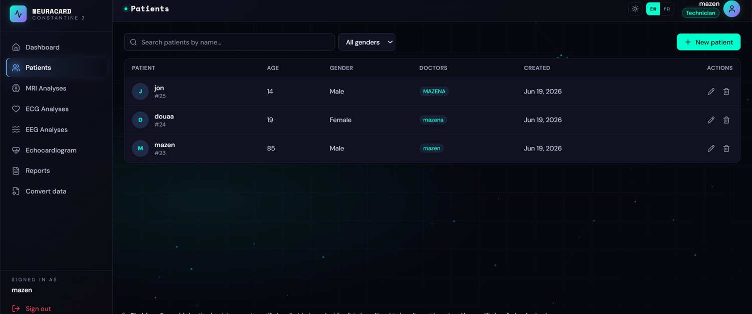
DEMONSTRATION · TECHNICIAN
Technician view
Sees all patients
Technician role for intake and routing across the hospital.
Assignment column
Each patient is routed to one or more doctors.
Convert & intake
Access to the data-conversion tool and patient assignment.
The back-office technician sees every patient and the doctors they are assigned to.
IMPLEMENTATION
NEURACARD · 21 / 33

Slide 22
PART 05
05
Results
Datasets · training pipeline · metrics · confusion · explainability
MRI 95.4% · ECG F1 0.777 · Echo MAE 4.01% · EEG 0.47
RESULTS
NEURACARD · 22 / 33

Slide 23
DATASET OVERVIEW
Five public benchmarks, one per modality
DATASET
MODEL
USED FOR
TRAIN / FINE-TUNE
Kaggle Brain-Tumour MRI · ~7,000 img
Swin-T
Tumour-type classification
Fine-tuned · 80.4 → 95.4%
LGG MRI Segmentation · 3,929 slices
U-Net
Tumour segmentation
Used as released · bug-fixed
PTB-XL
7× DenseNet-1D
Arrhythmia detection
Calibrated + 6/7 fine-tuned
EchoNet-Dynamic · EF
DeepLabV3 + R(2+1)D
EF + LV segmentation
Used as released
Kaggle HMS · patient split
BIOT + IIIC head
Harmful-activity screen
IIIC head trained
All datasets are public · validated on held-out splits (ECG thresholds tuned on fold 9, tested on fold 10; EEG split by patient). Teal = fine-tuned · violet = trained in-repo · grey = used as released.
RESULTS
NEURACARD · 23 / 33

Slide 24
PERFORMANCE METRICS
Headline results per model
MODEL
METRIC
RESULT
ALSO
MRI · type (Swin-T)
Accuracy
95.4%
macro F1 0.954
MRI · segmentation (U-Net)
Dice
0.852
IoU 0.78–0.80 ·
ECG · 7× DenseNet-1D
Macro F1
0.777
ROC-AUC 0.981 · bal-acc 0.896
Echo · EchoNet
EF MAE
4.01%
R² 0.831 · LV Dice 0.897
EEG · BIOT + IIIC
Balanced acc
0.47
seizure recall 0.949 · chance 0.167
RESULTS
NEURACARD · 24 / 33

Slide 25
EXPLAINABLE AI
Why every result can be questioned
Grad-CAM
SHAP (×4)
Faithfulness
Hooks the Swin final LayerNorm and folds tokens back to a spatial grid — a heatmap of where the classifier looked.
Captum GradientShap on all four models pixel saliency plus per-lead (ECG), per-channel (EEG) and per-frame (Echo) importance.
Grad-CAM ↔ SHAP agreement, peak-in-mask localization and a deletion causal test quantify the explanations.
RESULTS
NEURACARD · 25 / 33

Slide 26
PART 06
06
Business Model & Future
From a validated prototype to a venture — and the data-driven moat behind it.
Business Model Canvas · market opportunity · perspectives
The long-term vision: cross-modal brain–heart prediction
BUSINESS MODEL
NEURACARD · 26 / 33

Slide 27
BUSINESS MODEL CANVAS
BUSINESS MODEL CANVAS
Key Partners
Key Activities
Value Propositions
Sovereign cloud (Gecos, AlgérieTélécom)
medical-equipment distributors.
CDTA / CERIST
Multimodal R&D (missing-modality robust) ·
medical-device certification · cybersecurity & encryption
Holistic prognosis — cross-modal, months ahead · cost optimization · preventative care
Customer Relationships
Customer Segments
Key Resources
Clinical co-development ·
medical-grade SLA (99.9%) ·
explainable-AI (SHAP / Grad-CAM) portals
Private diagnostic & radiology centres (B2B) ·
CHUs & public hospitals
· CROs & universities
A100 / H100 GPU clusters ·
DL scientists & DICOM engineers · medical director + legal ·
curated datasets
Channels
Cost Structure
Revenue Streams
Direct PACS / DICOM integration · medical scientific societies ·
KOL advocacy
Tech payroll ·GPU compute ·
clinical trials & annotation ·
regulatory & legal ·
marketing
Enterprise SaaS ·
module licensing ·
public-CHU maintenance ·
on-prem setup fees
BUSINESS MODEL
NEURACARD · 27 / 33

Slide 28
BUSINESS MODEL · STRATEGY
On-premises hybrid built for Algerian hospitals
The challenge
Algerian hospitals will not let patient data leave their walls a pure cloud-SaaS model is nearly impossible for public institutions.
On-Premises Hybrid
AI models run on a secured server inside the hospital's own data room the architecture the whole business is built around.
BUSINESS MODEL
NEURACARD · 28 / 33

Slide 29
BUSINESS MODEL · FINANCIALS
Year 1–2 projection (Algerian Dinar)
REVENUE STREAMS
COST STRUCTURE
Enterprise SaaS · 5 centres
6.00 M
High-tier tech payroll
11.50 M
Module licensing · 20 clinics
8.00 M
GPU compute & servers
4.50 M
Clinical trial & annotation
3.50 M
CHU maintenance · 3 pilots
6.00 M
Regulatory & legal
2.50 M
On-prem setup · 25 sites
6.25 M
B2B marketing & events
1.50 M
TOTAL
26.25 M
TOTAL
23.50 M
PROJECTED NET SURPLUS · YEAR 1–2
+ 2.75 M DZD
BUSINESS MODEL
NEURACARD · 29 / 33

Slide 30
FUTURE PERSPECTIVES
Where NEURACARD goes next
The flagship goal cross-modal prediction
Use the paired, same-patient data the platform collects to train a model that predicts brain tumours from cardiac signals, and heart disease from brain imaging , operationalising the brain–heart axis.
Learned multimodal fusion
More modalities & diseases
Replace the rule-based report with a model that learns cross-modal correlations.
Add CT, PET and further pathologies behind the same plug-in contract.
Federated, multi-hospital
Mobile + multilingual reports
Train across sites without moving data — privacy by design.
Companion app; reports in Arabic, French and English.
BUSINESS MODEL
NEURACARD · 30 / 33

Slide 31
PART 07
07
CONCLUSION
INTRODUCTION
NEURACARD · 31 / 33

Slide 32
CONCLUSION
What this work delivers
NEURACARD delivers one integrated, explainable and honestly-measured platform that unifies four medical modalities : ECG, EEG, MRI and echocardiography in a single, doctor-isolated clinical workflow, from upload to a combined report.
Scientific
Engineering
Honesty
Four public models measured, calibrated and fine-tuned MRI 95.4%, ECG F1 0.777, Echo MAE 4.01%, EEG
A full-stack, role-based system with SHAP explainability across all four models, 3D anatomy and a combined PDF report.
Every number is from held-out public data, with limitations stated openly decision support with a human in the loop.
“Our ambition is to deploy NEURACARD across Algerian hospitals keeping data on-premises and to use the paired, same-patient data it collects to build the first model that predicts across the brain–heart axis and more.”
CONCLUSION
NEURACARD · 32 / 33

Slide 33
Thank you for your attention.
Questions & Answers
RAMOUL Mazen · mazen.ramoul@univ-constantine2.dz
With sincere thanks to Pr. DERDOUR Makhlouf & Pr. TALBI Hichem, and to the jury.
University of Abdelhamid Mehri — Constantine 2 · Faculty of NTIC · June 2026

